Slide 1
Powerpoint for report
Max Austin - Mada2

Slide 2
Motivation
Why UK Trade?
Large, rich dataset available from the CEPII BACI database
Personal interest in international trade and forecasting
Relevant Skills Developed
Deep learning using TensorFlow in both R and Python
Classification models:
Predict future trade based on historical features
Clustering techniques:
Group similar trade items or partners
Applied K-means to identify patterns

Slide 3
Research Questions
Can we forecast future UK trade data?
Total exports and imports
Will overall trade grow or decline?
Trade by product
Which goods will dominate?
Trade by partner country
Will new countries become more prominent?
Challenges of forecasting long-term trade
Economic shocks (e.g., COVID-19, financial crises)
Policy and geopolitical uncertainty (e.g., Brexit)
Structural changes in industry or consumer demand
Model limitations for long-term prediction

Slide 4
Overview of Data
The original dataset from the CEPII BACI database contained 258 million+ rows, covering:
Trade flows between 238 countries
Over 5,000 products using 6-digit Harmonized System (HS) codes
Annual data from 1995 to 2023
Preprocessing steps included:
Filtering rows where the UK was either importer or exporter
Merging similar products (e.g., combining 21 categories of “meat” into one)
Decoding numeric country and product codes into readable labels
Cleaning and reducing the dataset to around 5 million rows for focused analysis

Slide 5
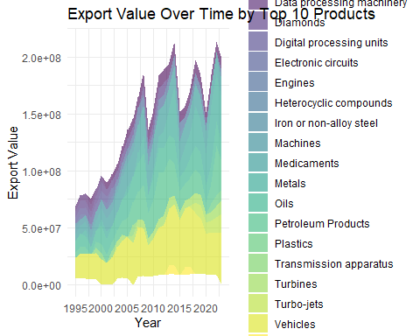

Slide 6
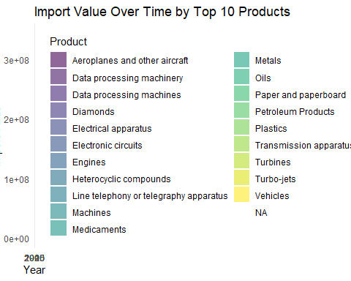

Slide 7
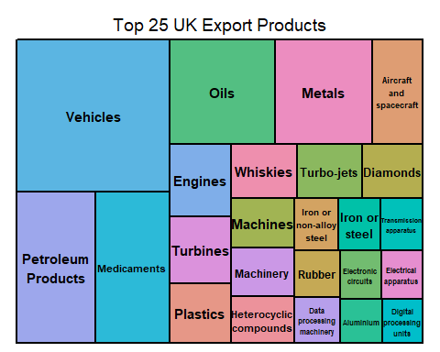

Slide 8
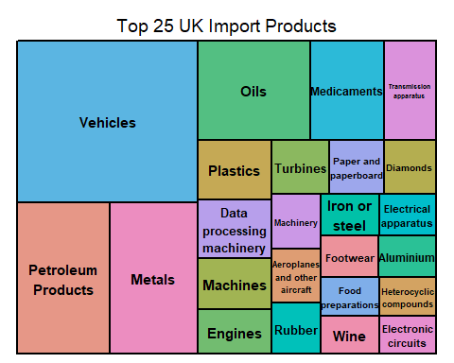

Slide 9
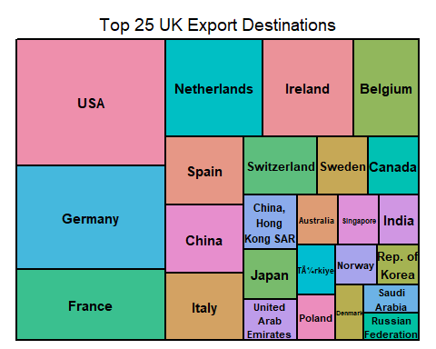

Slide 10
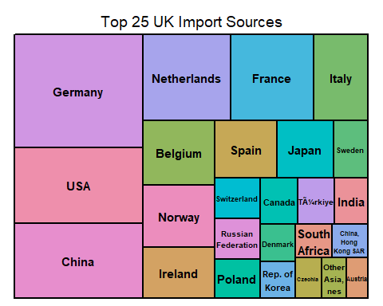
Treemap of exports by importer

Slide 11
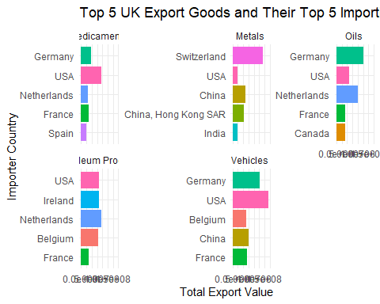

Slide 12
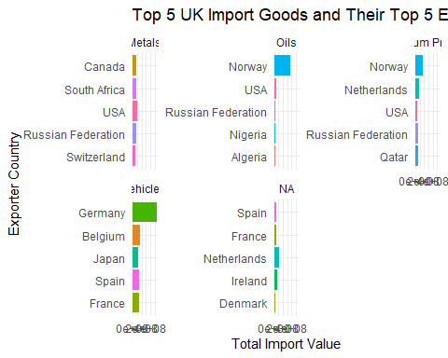

Slide 13
Overview of methodology
Correlation Analysis
Explore how different products and trade partners move together
Identify strong relationships between key sectors (e.g., aerospace, energy)
Clustering
Group similar products based on trade patterns
Used K-means and network-based methods to uncover hidden structure
Deep Learning
Developed two neural network models to forecast future trade
One model for UK as exporter, another for importer
Embedded categorical variables and scaled numeric ones

Slide 14
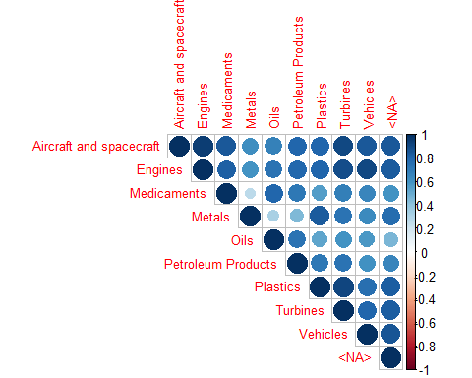
Correlation Between Top Export Products

Slide 15
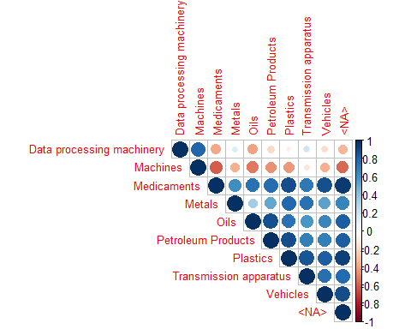
Correlation Between Top Import Products

Slide 16
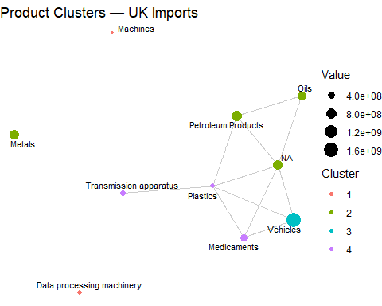

Slide 17
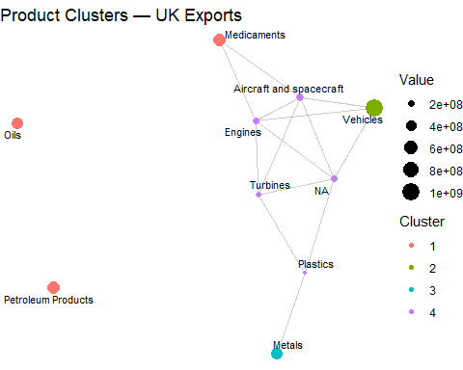

Slide 18
Deep Learning
What is Deep Learning? Multi-layer neural networks that excel at learning complex, non‑linear patterns.
Our Approach
Two autoregressive LSTM models in R (Keras + TensorFlow 2.10)
Exporter model: UK as exporter → predict exports
Importer model: UK as importer → predict imports
Inputs:
Categorical: partner country & product → learnable embeddings
Numeric: year + lag₁–lag₃ trade values → standardized (zero mean, unit variance)
Architecture:
Embedding layers →
Dense projection →
RepeatVector →
LSTM →
Dense → output
Training Details
20 epochs, batch size 216
Mixed‑precision (mixed_float16) for speed
Loss: MSE; Metric: MAE
20% validation split, shuffle each epoch

Slide 19
Model Comparison
Benchmarks
Linear Regression
Pros: simple, interpretable
Cons: no memory of past values, misses non‑linear trends
Random Forest Regression
Pros: captures non‑linearity
Cons: unstable time‑series forecasts, prone to overfitting
Autoregressive LSTM
Leverages lagged history to capture sequential dependencies
Learned embeddings for high‑cardinality categoricals
Produces smoother, more consistent forecasts
Achieved lowest MAE on hold‑out data

Slide 20
Conclusion
Key Takeaways
UK’s trade deficit is structural and forecast to persist
Vehicles, pharmaceuticals, machinery dominate exports
Germany, China, USA, Norway lead in imports
Deep Learning Strengths
Captures long‑term momentum via autoregressive LSTM
Robust high‑level forecasts across products & partners
Outperforms simpler baselines on MAE
Limitations & Next Steps
Smooth, conservative outputs understate shocks or policy changes
Does not include exogenous variables or regime shifts
Future work:
Integrate macro‑economic indicators (GDP, exchange rates, policy events)
Incorporate graph/cluster embeddings or attention models
Add shock-detection or switching‑regime components

